Slide 1


MetLife, Inc. Analyst: Yada So Valuation Date: Nov/16/2023

Slide 2
Recommendation
Stock Rating | BUY
Target Price | $69.85
Current Price | $62.03
Upside | 12.6%
Strong brand name and large distribution network continue to drive growth in premiums
Higher interest rate environment increases revenue from fixed income securities
Lower mortality rate than Covid-19 period

Slide 3
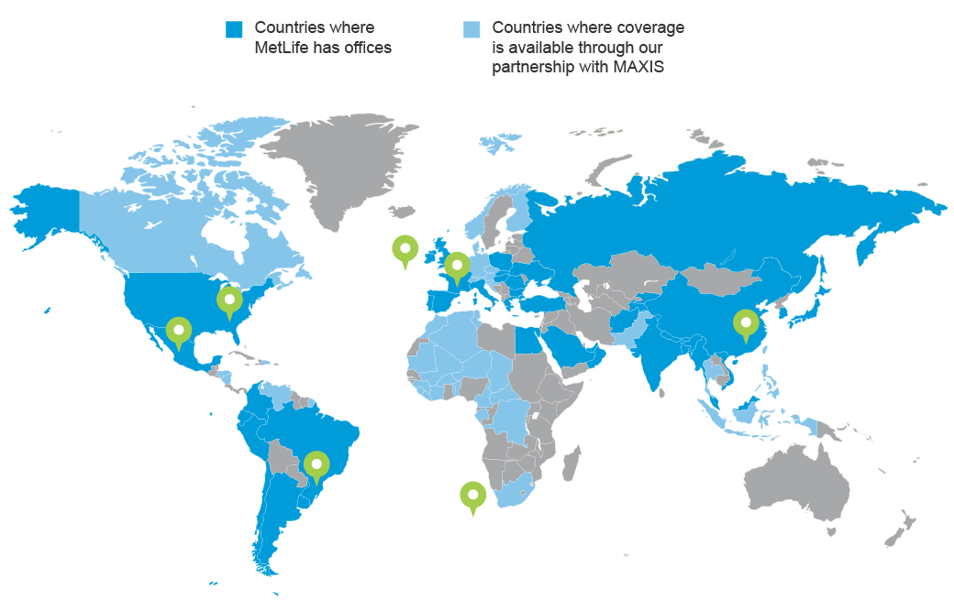
Company Overview
Founded: 1868
Headquarters: New York City, New York
Core businesses: Life Insurance, Annuities,
Accident & Health,
Other insurance
Investment
Market Cap: ~ 45.9B
FY2022 Revenue: ~69.9B
Employed: ~45,000 (as of Dec 2022)

Slide 4
Revenue

Slide 5
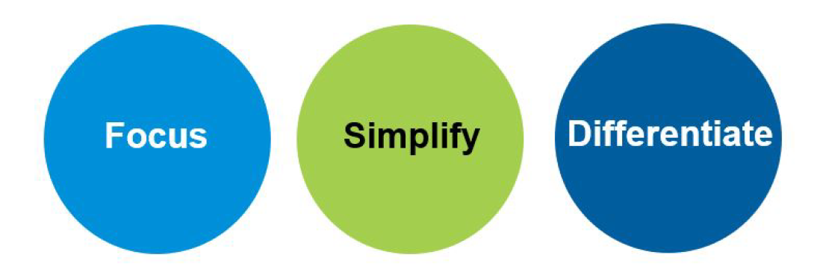
Next Horizon Strategy
Improved underwriting discipline over the past several years
Focus: Generate strong free cash flow by deploying capital to the highest value opportunities.
Simplify: Simplify its business to deliver operational efficiency
Differentiate: Drive competitive advantage through its brand, scale, talent, and innovation.

Slide 6
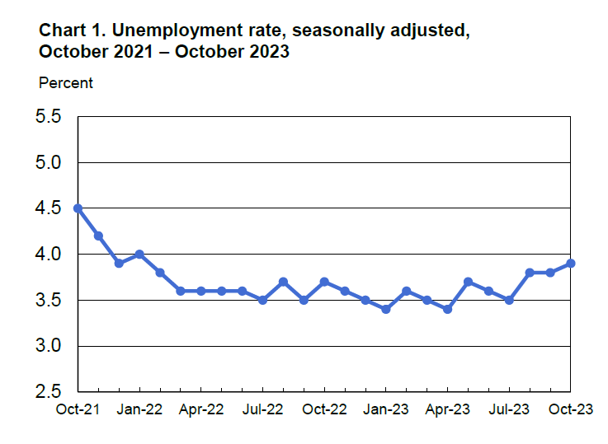
Industry Analysis
Life insurance and Annuities in the US
2018-2023 Revenue CAGR: 2.5%
2023-2028 Revenue CAGR: 0.5%
Source: IBISWorld
Source: Bureau of Labor Statistics

Slide 7
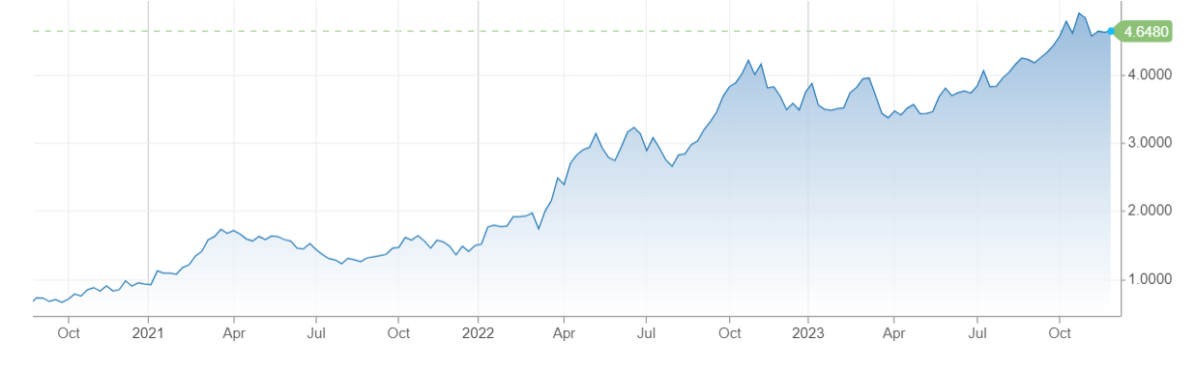
Industry Analysis
U.S. 10 Year Treasury Note
Investment from life insurance companies in fixed income securities:
50% of total investment
$4.1 trillion
Source: American Council of Life Insurers
Source: CNBC

Slide 8
Porter’s Five Forces
Competitive Rivalry: High
More than 700 life insurance companies in the US
Bargaining Power of Customers: High
Competition is based on price.
Threat of New Entry: Low
Strict regulation and capital intensity

Slide 9
Forecast Revenue
Key Drivers
Slower Growth in Premiums
High interest rates will limit growth in premiums
2018-2022 Premiums CAGR: 2.5%
2024-2028 Premiums Forecast CAGR: 1.8%
Higher Investment Income
Higher yield on investment in fixed income securities
2021: 3.7%
2023: 4.1%
Lower Mortality Rate
2021: 103.3% (during pandemic period)
2023: 86.5%

Slide 10
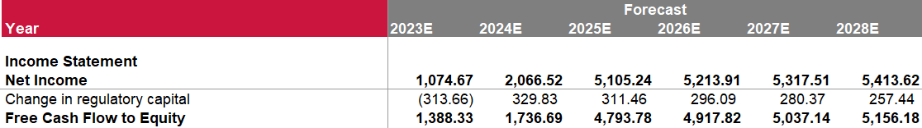
FCFE
Valuation
Beta = 1.06
Cost of Equity = 10.58%
Terminal Growth Rate: 2%
Target Price
Target Price: $72.00
Current Price: $62.03
Upside: 16.07%

Slide 11
Relative Valuation
P/E Valuation (50%)
Company | Market Cap ($M) | Revenue | Forward P/E | P/B
MetLife Inc | 44,729.70 | 64,613.00 | 7.43 | 1.10
Aflac | 47,568.50 | 19,233.00 | 13.65 | 1.85
Manulife | 46,148.90 | 20,087.00 | 4.09 | 0.78
AIG | 44,741.00 | 50,151.00 | 9.29 | 0.77
Sun Life Financial | 38,177.40 | 25,254.00 | 5.47 | 1.41
Great-West Lifeco | 37,461.20 | 44,984.00 | 12.37 | 1.36
Prudential | 33,172.20 | 51,527.00 | 7.38 | 0.99
Principal Financial | 16,800.90 | 14,081.30 | 10.52 | 1.10
Globe Life | 11,003.80 | 5,355.00 | 10.60 | 1.56
Median |  |  | 9.29 | 1.1
Target Price: $60.88
P/B (50%)
Target Price: $74.53
TARGET PRICE
Target Price: $ 67.70
Current Price: $62.03
Upside: 9.15%

Slide 12
Final Valuation
DCF Valuation (50%)
$ 72.00
Relative Valuation (50%)
$67.70
Target Price
PRICE: $ 69.85
UPSIDE: 12.61%
(current price: $62.03)
Upside: 16.07%
Upside: 9.15%

Slide 13
Financial Analysis
Loss on interest rate derivatives in 2022: $3.9B
Accumulated other comprehensive loss in 2022: $27B

Slide 14
Financial Analysis

Slide 15
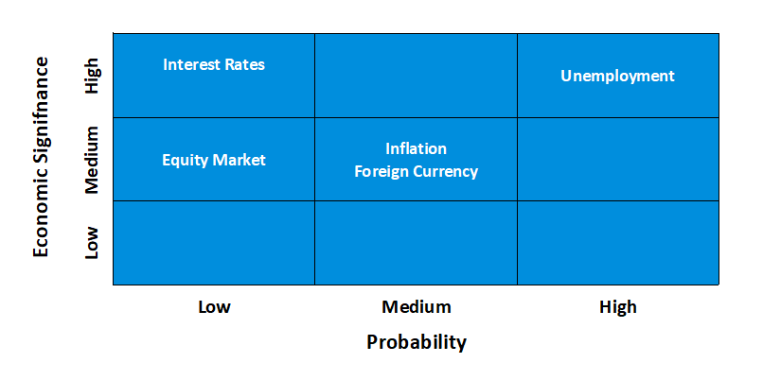
Investment Risk

Slide 16
ESG
Risk of being designated as Systemically important financial institution (SIFI)
Compliance with insurance regulations in many countries
Challenge in keeping personal data of millions of customers

Slide 17
Recommendation
Stock Rating | BUY
Target Price | $69.85
Current Price | $62.03
Upside | 12.61%
Strong brand name and large distribution network continue to drive growth in premiums
Higher interest rate environment increase revenue from fixed income securities
Lower mortality rate than Covid-19 period

Slide 18
Appendix

Slide 27
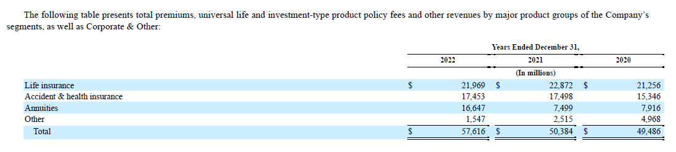

Slide 28
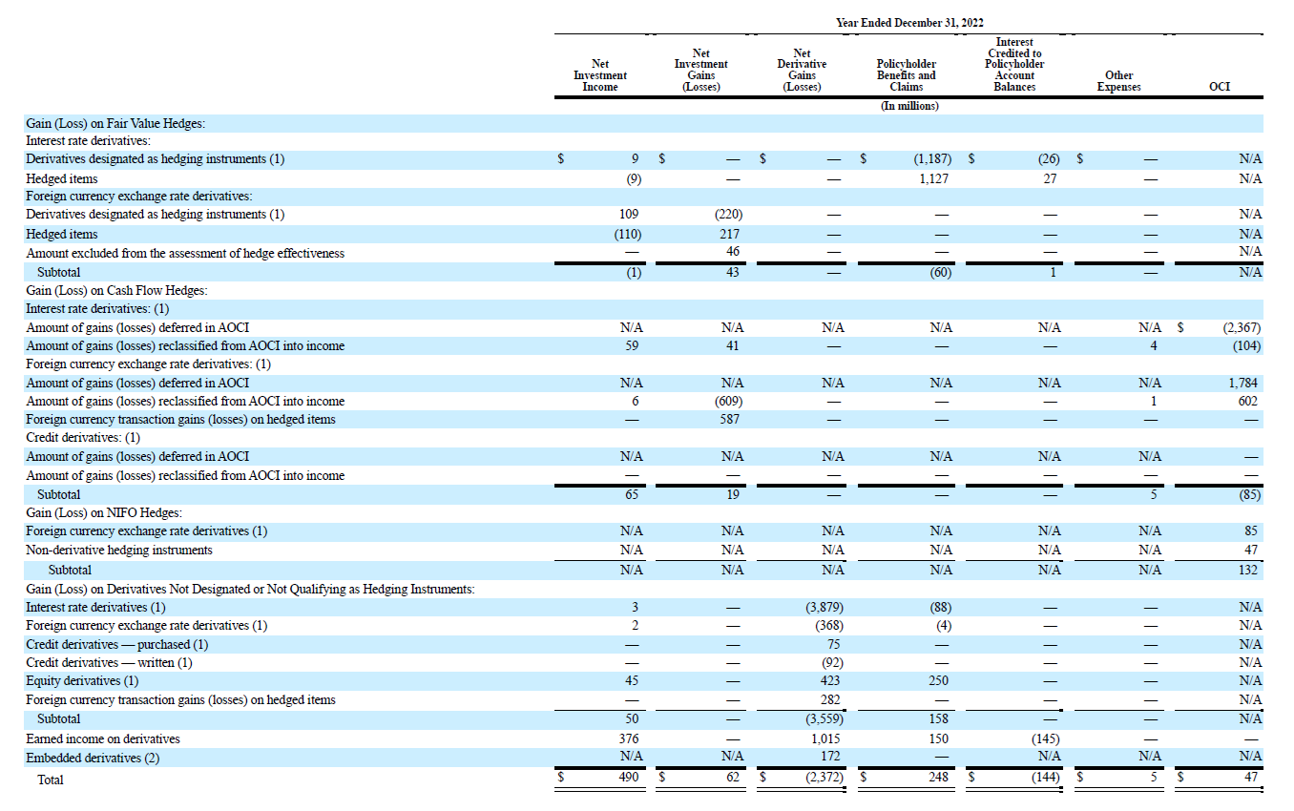

Slide 29
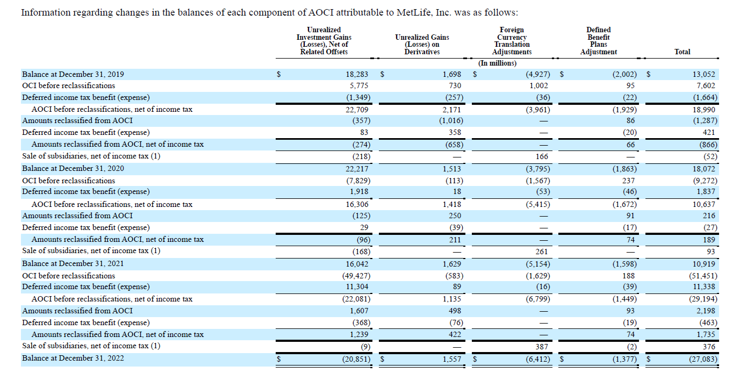

Slide 30
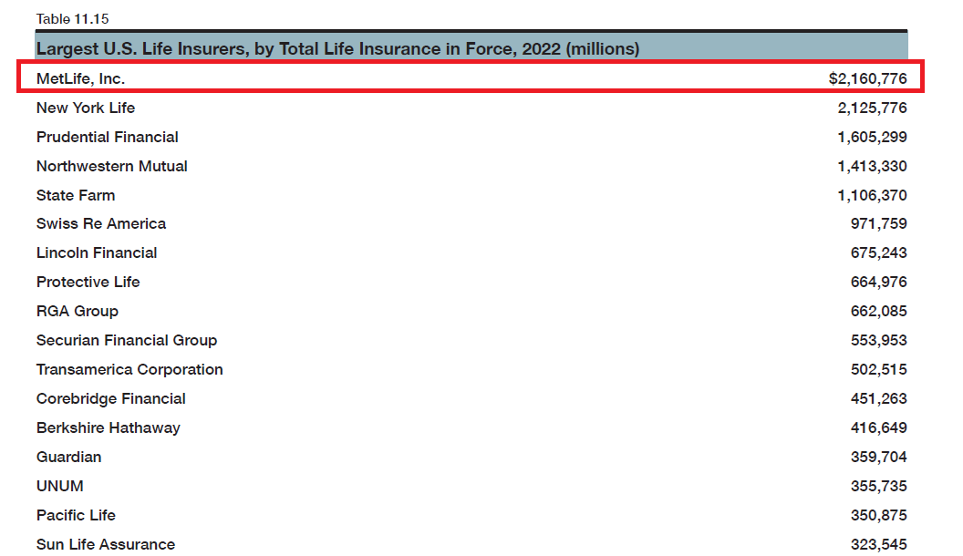
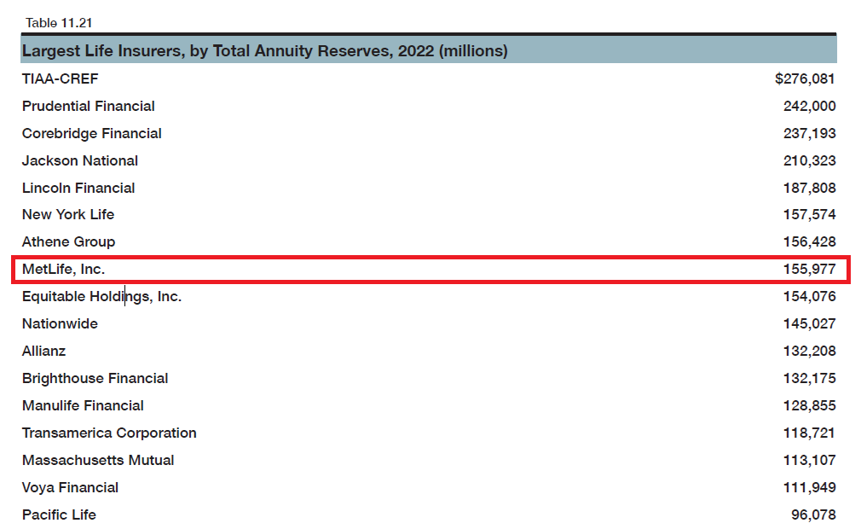

Slide 31
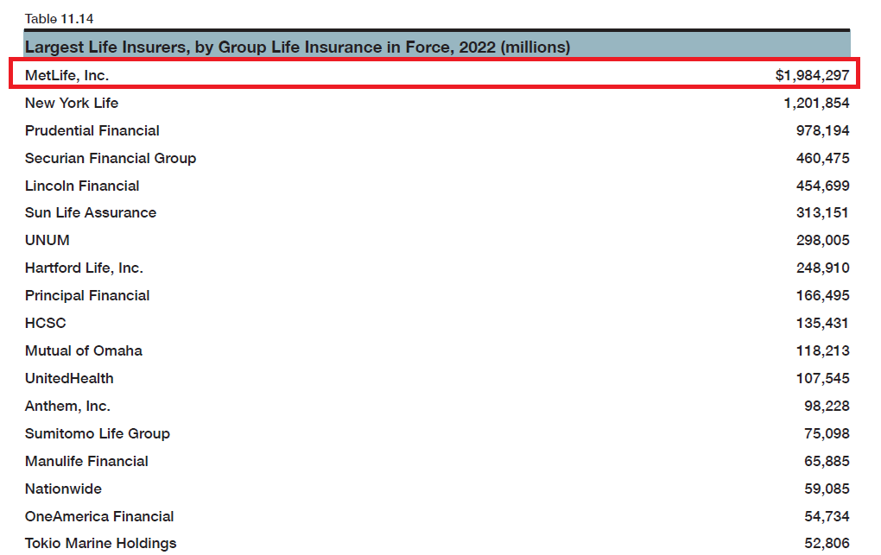
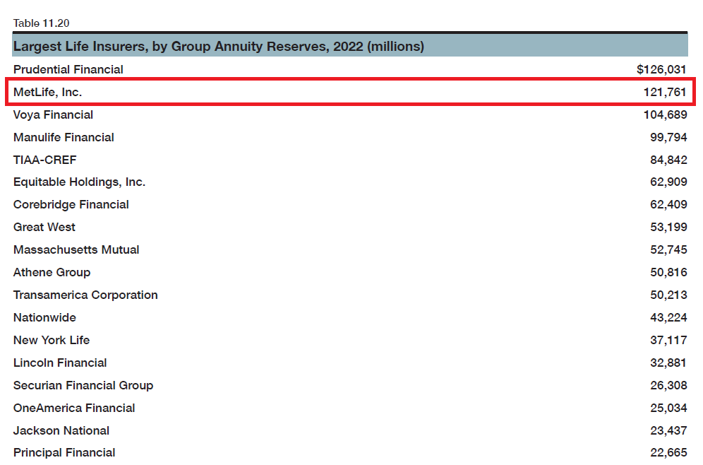

Slide 32
